Slide 1
Native Landing App
NativeScript + Angular.io + Google Sheets + Heroku
https://github.com/PlusOneGeneration/native-landing-app

Slide 2
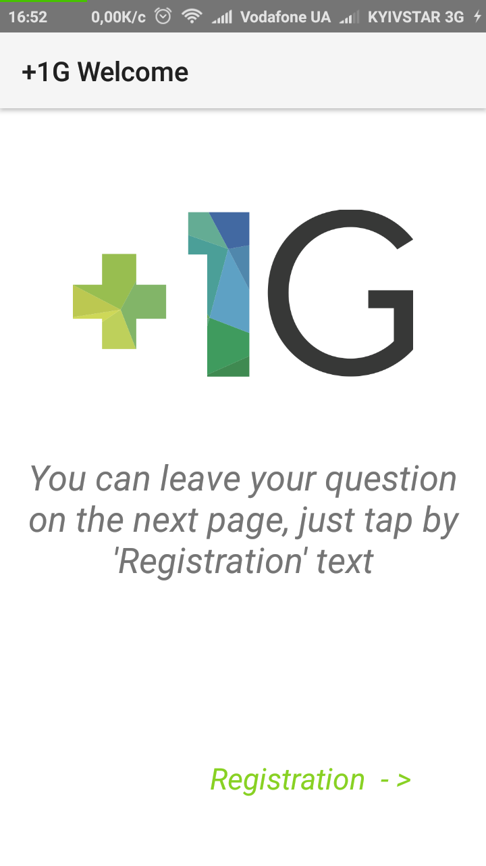
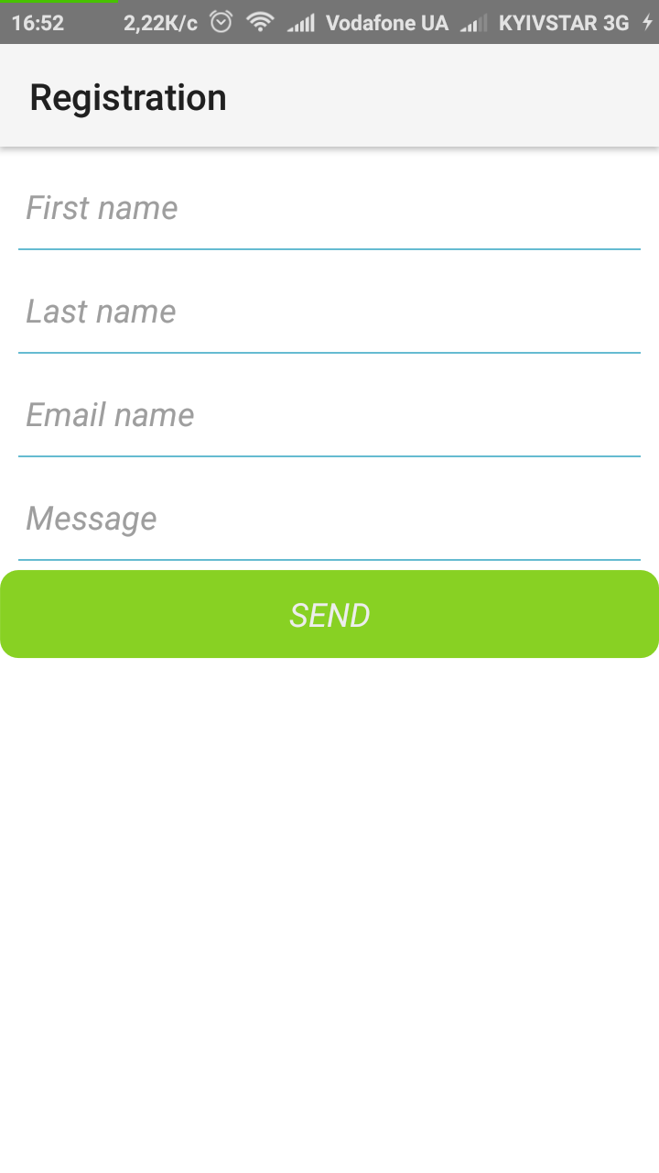
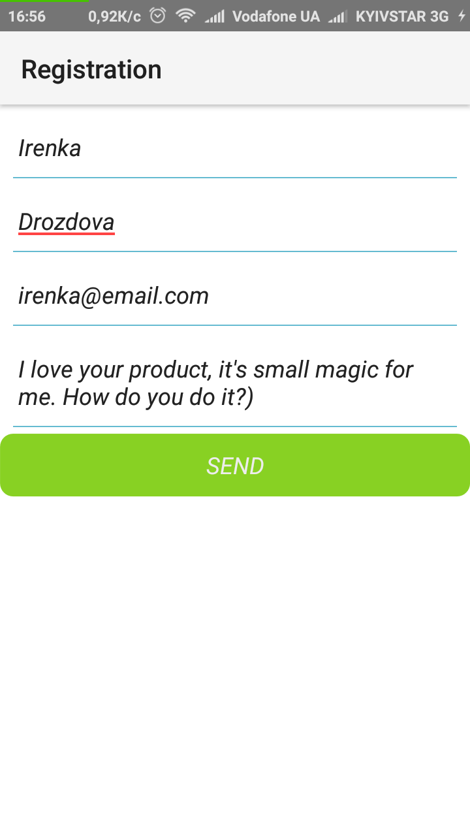
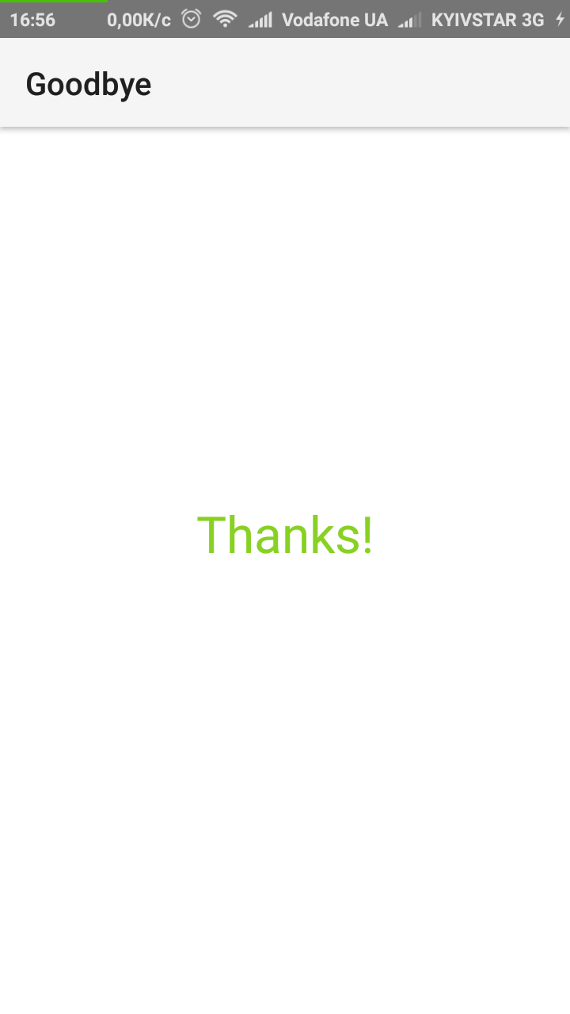
Preview the finished app

Slide 3
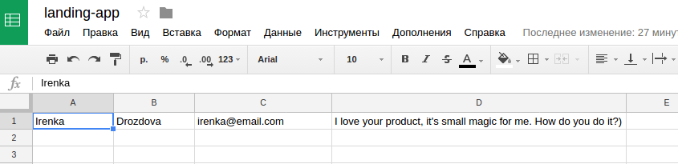
What we can see on Google Sheets

Slide 4
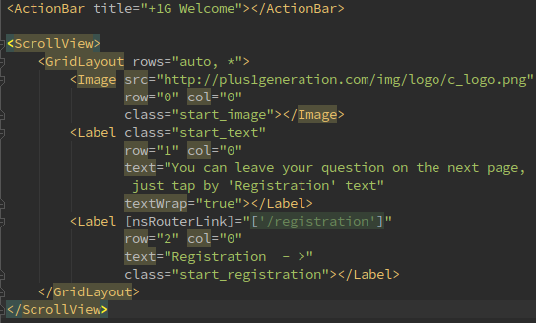
The first step - NativeScript + Angular -Start page

Slide 5
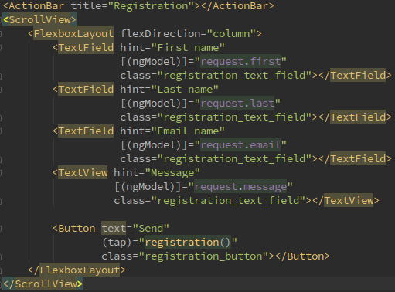
Registration page

Slide 6
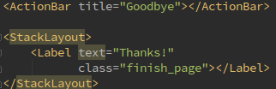
Finish page

Slide 7
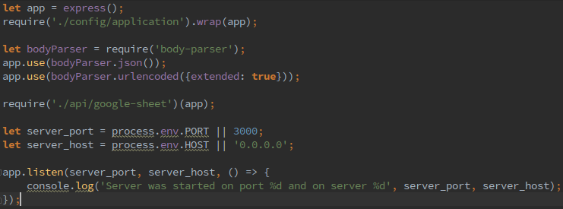
The second step - Express - app.js

Slide 8
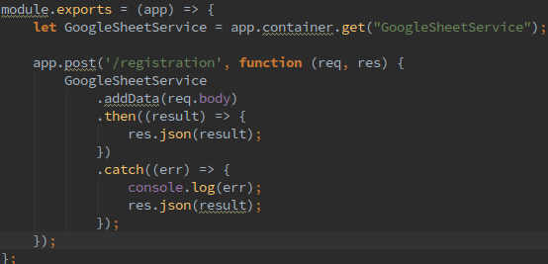
Google-sheet.js

Slide 9
The third step - Connect to Google Sheets
For start: Google account; Google console App;
When you have Google App: - need to get credentials for app - get .json file with information about your Google App - add this file to your application - install two npm packages: npm install google-auth-library --save npm install googleapis --save
Good tutorial for this task with examples: http://voidcanvas.com/node-js-googleapis-v4-spreadsheet/

Slide 10
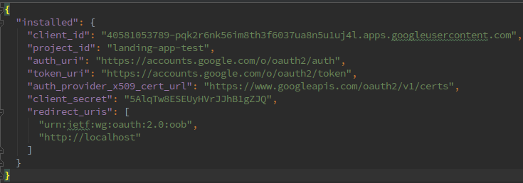
How looks .json file from Google
Good tutorial for this task with examples: http://voidcanvas.com/node-js-googleapis-v4-spreadsheet/

Slide 11
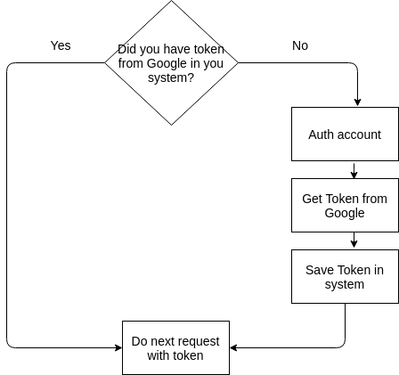
Google Authentication.js
Good tutorial for this task with examples: http://voidcanvas.com/node-js-googleapis-v4-spreadsheet/

Slide 12
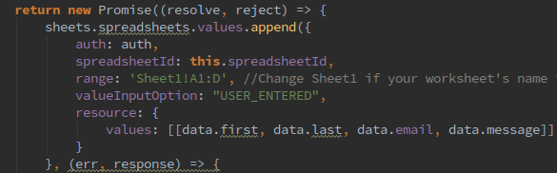
Example code for adding data to list

Slide 13
Help by Google
Node.js Quickstart
https://developers.google.com/sheets/api/quickstart/nodejs
Google Sheets API
https://developers.google.com/sheets/api/reference/rest/
Additionally for Google Sheets
https://developers.google.com/sheets/api/guides/concepts

Slide 14
The fourth step - Share server side on Heroku
For start: Heroku account; Node Js; Npm; Git; Ready Server App
Heroku Login
Deploy App to Heroku
$ heroku login Enter your Heroku credentials. Email: yourheroku@email Password: yourheroku_pass
$ heroku create app-name -- buildpack heroku/nodejs $ git push heroku master $ heroku ps:scale web=1 $ heroku logs --tail --app app-name
Heroku uses npm start command by default
For change command for start your app - create Procfile.txt and add command like this:
web: npm run start.heroku

Slide 15
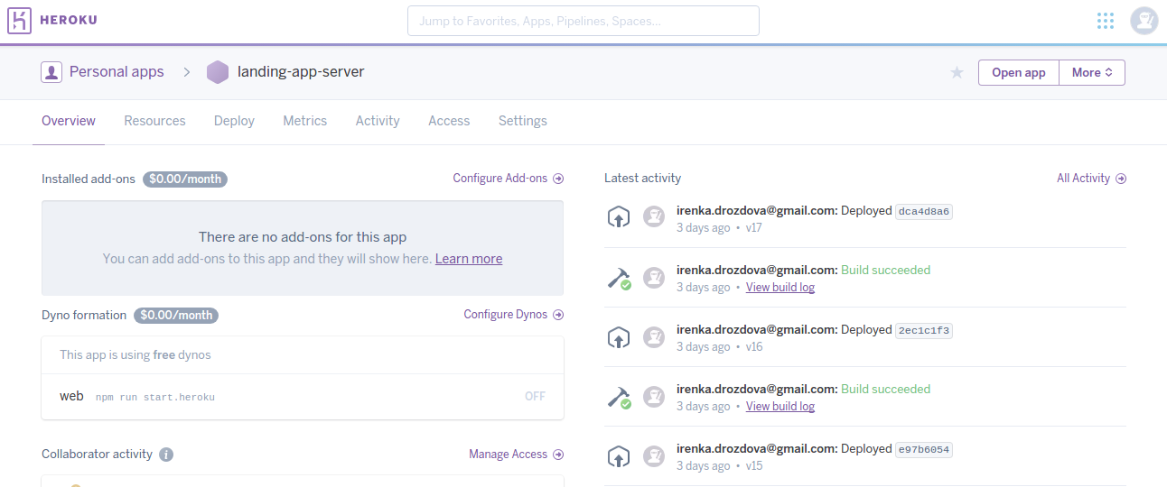
Heroku Account + App

Slide 16
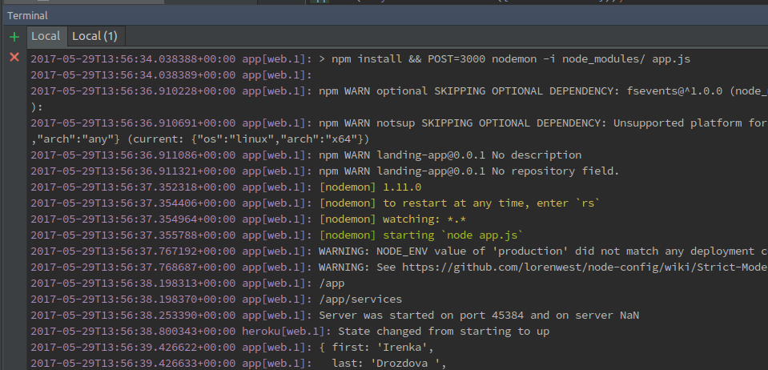
Heroku console

Slide 17
Help by Heroku
Get started
https://devcenter.heroku.com/start
Buildpacks
:https://devcenter.heroku.com/articles/buildpacks#setting-a-buildpack-on-an-application
Heroku Error Codes
https://devcenter.heroku.com/articles/error-codes

Slide 18
Q / A

